Slide 1
Software Engineering and Architecture
Pattern Catalog: Façade

Slide 2
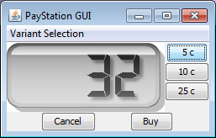
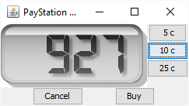
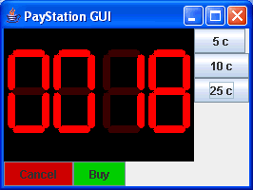
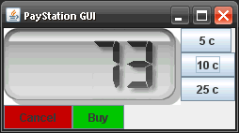
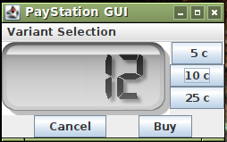
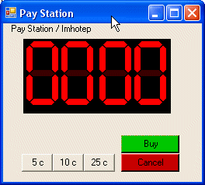
New Requirement
It would be nice with a simple GUI “to see something” instead of just xUnit tests...
“The GUI History of PayStation” ☺
Notes:
Meta: Code demo in ‘frsproject/paystation-many-to-many’

Slide 3
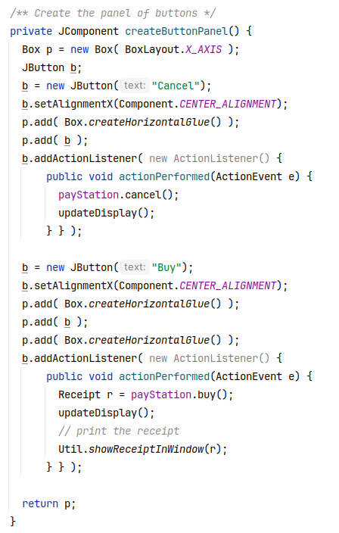
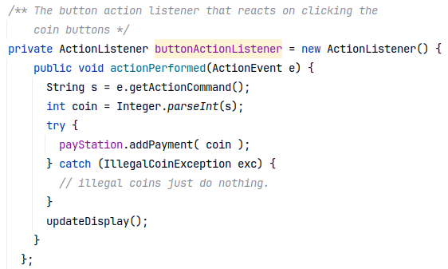
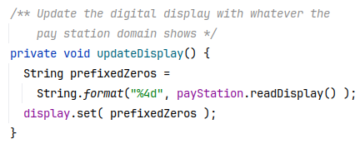
[Demo]

Slide 4
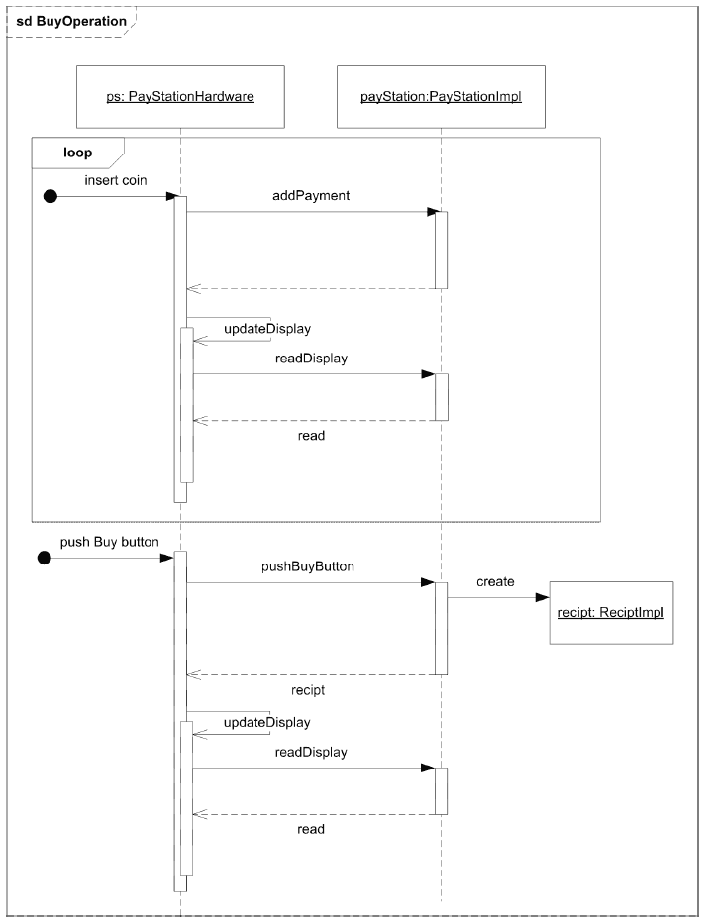
Analysis
Seq Diagram
No difference in behavior of a GUI versus real hardware!

Slide 5
Conclusion
Any kind of user interface can operate the PayStation!
Wow – Change by addition...
How come we are so lucky?

Slide 6
Design considerations
③ Behavior that may vary
the same hardware (or GUI) must operate varying pay station implementations: AlphaTown, BetaTown, EpsilonTown...
① Variable behavior behind interface
PayStation interface...
② Compose behavior by delegation
Gui/Hardware does not itself calculate rates, issue receipts, etc., but lets an instance of PayStation do the dirty job...

Slide 7
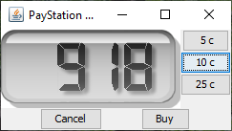
Result
The side effect of this decision is that interface decouples both ways!!!
User interfaces may operate different kinds of PayStation implementations
Alpha, Beta, Gamma, …
Different kinds of user interfaces may operate the same PayStation implementation
<<interface>>
PayStation
*
*
<<interface>>
PayStationGUI
Notes:
Demo: dSoftArk E09 / many-to-many

Slide 8
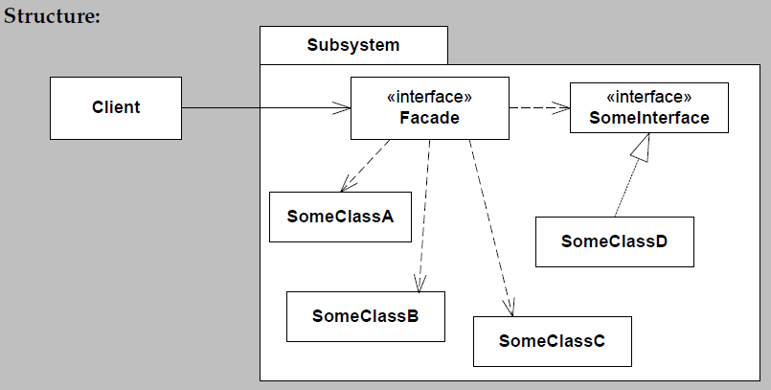
Automagical pattern?
PayStation is an example of the Façade pattern
C

Slide 9
Consequences
Benefits
Shields clients from subsystem objects
(depends… Consider HotStone)
Weak coupling
Many to many relation between client and façade
Liabilities
Bloated interface with lots of methods
Because façade must have the sum of responsibilities of the subsystem
How to avoid access to the inner objects?
Read-only interfaces for “outside”, and private interfaces (mutating) on the “inside” of the façade/sub system boundary

Slide 10
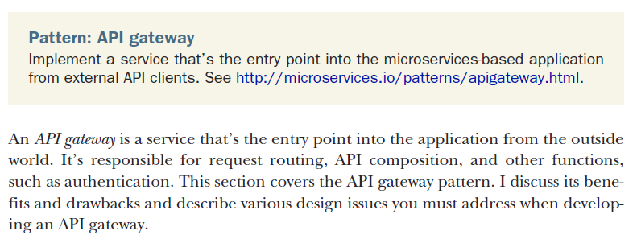
Facade Variants
Facade appears on all levels of architecture!
An Java Interface is a ‘small scale’ Facade…
The Layered architectural style defines a set of Facades
At remote service level, we have API Gateway

Slide 11
Compiler
A Compiler is a pretty complex piece of software
You will learn soon enough ☺ ‘Oversættelse’
Lexical analyzer, Syntax Analysis, Parser, Symbol table, Code generator…
Hidden behind an extremely simple Façade
‘javac HelloWorld.java’
The façade has one method
public ClassFile compile(String filename)

